Slide 1
TCP连接管理

Slide 2
TCP Connection Management
Recall: TCP sender, receiver establish “connection” before exchanging data segments
initialize TCP variables:
seq. #s
buffers, flow control info (e.g. RcvWindow)
client: connection initiator
Socket clientSocket = new Socket("hostname","port number");
server: contacted by client
Socket connectionSocket = welcomeSocket.accept();
Three way handshake:
Step 1: client host sends TCP SYN segment to server
specifies initial seq #
no data
Step 2: server host receives SYN, replies with SYNACK segment
server allocates buffers
specifies server initial seq. #
Step 3: client receives SYNACK, replies with ACK segment, which may contain data

Slide 3

Three way handshake
client state
server state
choose init seq num, x
send TCP SYN msg
SYNbit=1, Seq=x
choose init seq num, y
send TCP SYNACK
msg, acking SYN
SYNbit=1, Seq=y
ACKbit=1; ACKnum=x+1
received SYNACK(x)
indicates server is live;
send ACK for SYNACK;
this segment may contain
client-to-server data
ACKbit=1, ACKnum=y+1
received ACK(y)
indicates client is live

Slide 4
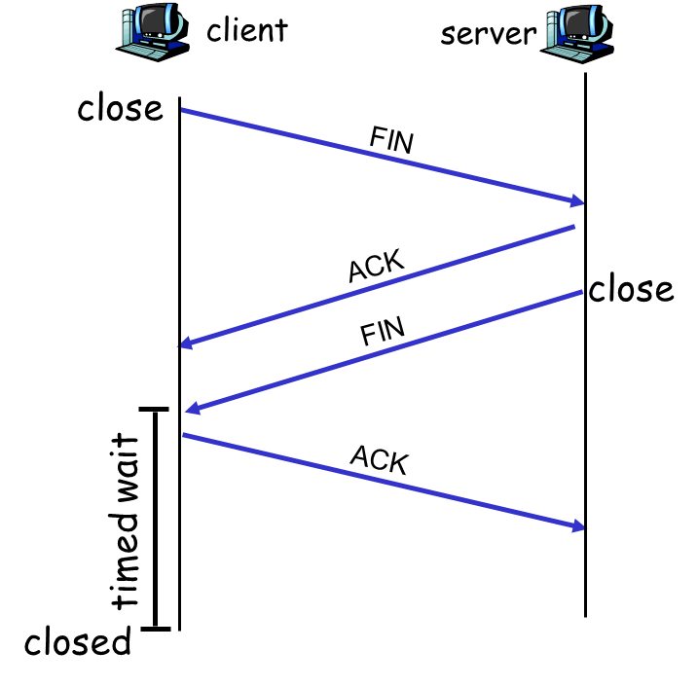
TCP Connection Management (cont.)
Closing a connection:
client closes socket: clientSocket.close();
Step 1: client end system sends TCP FIN control segment to server
Step 2: server receives FIN, replies with ACK. Closes connection, sends FIN.

Slide 5
TCP Connection Management (cont.)
Step 3: client receives FIN, replies with ACK.
Enters “timed wait” - will respond with ACK to received FINs
Step 4: server, receives ACK. Connection closed.
Note: with small modification, can handle simultaneous FINs.

Slide 6

Summary
Three way handshake
Closing a connection

